Slide 1








Real-Time WMS: Concurrency Safety in Databases
Implementing Pessimistic Locking & ACID Transactions in PostgreSQL
[Jianduojie Dan] | Database Systems Final Project
Ensuring Data Integrity

Slide 2














The "Flash Sale" Challenge
User 1
User 2
User 3
Scenario: 100 users try to buy the last iPhone simultaneously.
iPhone
The Risk: Race Condition occurs when multiple transactions read-modify-write the same data.
1
Available
The Failure: "Overselling" - Inventory drops to -99.
Read Quantity: 1
Why: Read-Modify-Write cycles overlap without proper locking.
Decrement by 1
Decrement by 1
Decrement by 1
Final Quantity: -99 (Oversold!)
Real-Time WMS: Concurrency Safety in Databases
2/7

Slide 3












3NF Schema & Design
6 Core Tables: Normalized design for Products, Warehouses, and Orders.
Third Normal Form Benefits
Eliminates redundancy
Ensures data integrity
Optimizes storage
Dual-State Tracking: Separated Inventory (Current State) from Stock_Movements (Audit Log).
Core Tables
Dual Tracking
Products, Warehouses, Orders, Inventory, Stock_Movements, Order_Items
Separates current inventory state from transaction history
Hard Constraint: CHECK (quantity >= 0) as the final defense line.
Hard Constraints
ACID Compliance
CHECK (quantity >= 0) as final defense line
Ensures transactional integrity
Real-Time WMS: Concurrency Safety in Databases
3/7

Slide 4
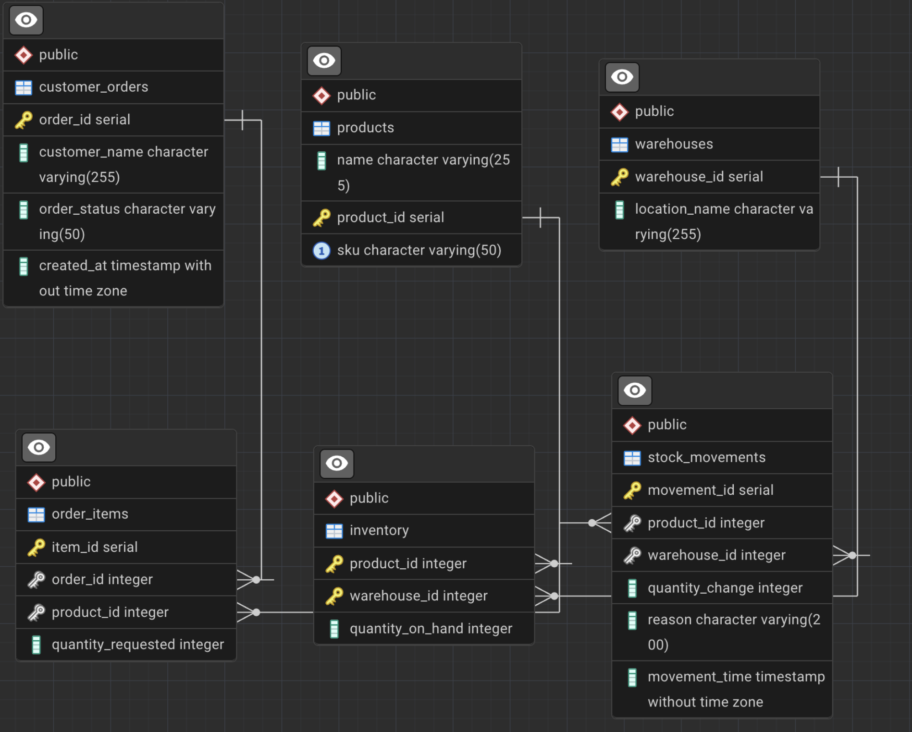

Slide 5















Pessimistic Locking Strategy
How we stop the race condition
Mechanism: PostgreSQL SELECT ... FOR UPDATE
Prevents race conditions by locking rows during transaction processing, ensuring data consistency in concurrent environments.
1
Transaction Begins
2
Lock Row
3
Queue
4
Update & Commit
User A executes BEGIN;
User A locks specific inventory row
User B waits until User A finishes
Update inventory and commit transaction
Implementation Example:
SQL Query
SELECT quantity FROM inventory
WHERE product_id=5
FOR UPDATE;
This query locks the row until the transaction commits, preventing other transactions from modifying it.
Real-Time WMS: Concurrency Safety in Databases
4/7

Slide 6










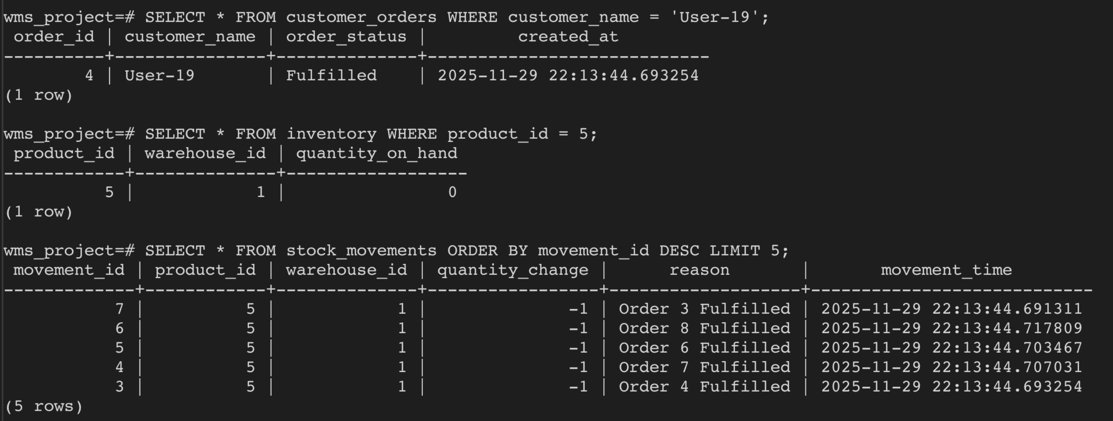
Stress Test Results
Simulated 20 concurrent threads via Python script (wms_test.py)
Inventory
SUCCESS
Orders
SUCCESS
Audit Log
SUCCESS
0
5
5
Final Quantity
Successful Orders
Movement Records
No negative inventory values
Matched inventory availability
Exact match with orders
Real-Time WMS: Concurrency Safety in Databases
5/7

Slide 7





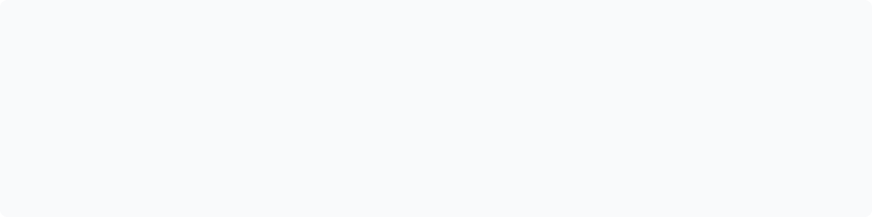





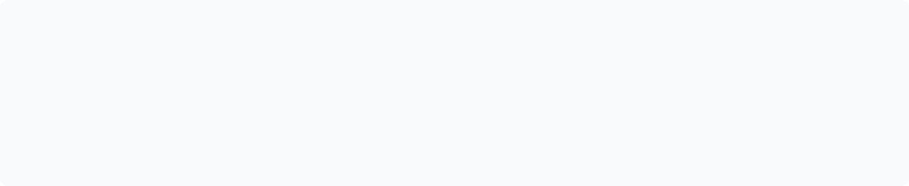
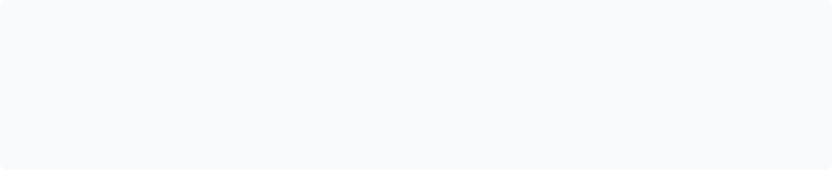
Beyond Transactions
Advanced optimizations for production readiness
Performance Indexes
Analytical Capabilities
Custom indexes on movement_time enable fast history queries.
CTEs calculate "Available-to-Sell" (Physical Stock - Reserved).
CREATE INDEX idx_movements_time ON stock_movements(movement_time);
WITH reserved AS (SELECT product_id, SUM(quantity) FROM orders WHERE status='reserved' GROUP BY product_id) SELECT p.product_id, (p.quantity - COALESCE(r.quantity, 0)) AS available FROM products p LEFT JOIN reserved r ON p.product_id = r.product_id;
Sales Insights
Reliability
Window functions provide powerful sales trend analysis capabilities.
Full pg_dump backup strategy ensures data recovery.
#!/bin/bash
pg_dump -h localhost -p 5432 -U wms_user wms_database > backup_$(date +%Y%m%d).sql
gzip backup_$(date +%Y%m%d).sql
SELECT product_id, movement_time, quantity, SUM(quantity) OVER (PARTITION BY product_id ORDER BY movement_time ROWS BETWEEN 6 PRECEDING AND CURRENT ROW) AS trend FROM stock_movements WHERE type='sale';
Real-Time WMS: Concurrency Safety in Databases
6/7

Slide 8








Project Summary
Normalized Schema
Concurrency Solutions
Designed a scalable 3NF schema with dual-state inventory tracking and hard constraint checks.
Implemented pessimistic locking strategy to prevent race conditions and overselling.
Stress Testing
Production-Ready
Verified system integrity through Python-based stress testing with 20 concurrent threads.
Delivered a robust backend implementation with analytics, optimization, and reliability features.
Questions & Answers
Thank you for your attention. Let's discuss the implementation details and test results.
Real-Time WMS: Concurrency Safety in Databases
7/7

